Slide 1

Real Estate Website Management
SE1414-Group 3
Lecturer: Phạm Ngọc Hà

Slide 2
ABOUT US
HE140233 Hà Văn Quang
HE140271 Nguyễn Thành Long
HE140298 Nguyễn Trọng Duy An
HE140305 Hoàng Đức Trường
HE140309 Hà Phẩm Cương

Slide 3

Software Requirement Specification

Slide 4
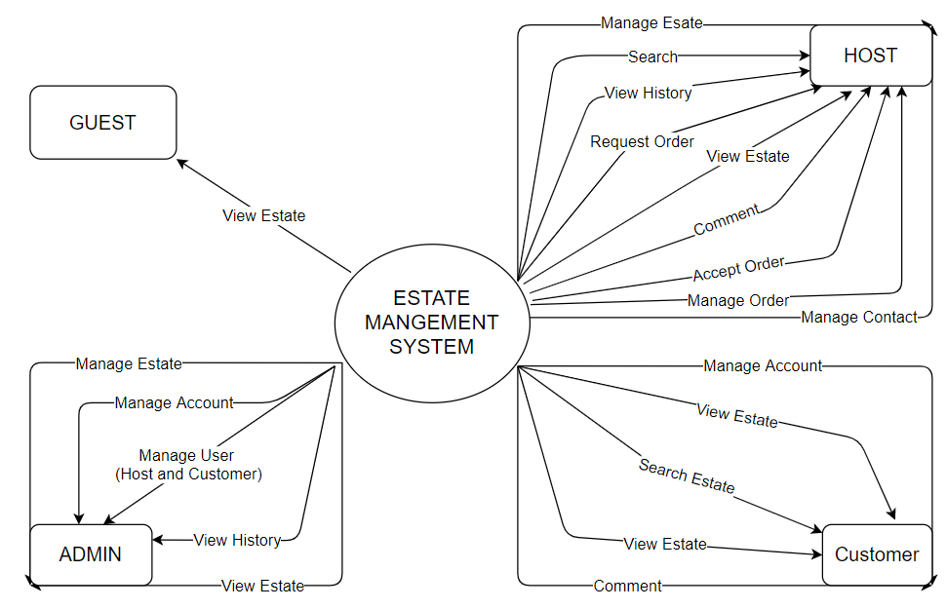
1.Overall Description 1.1 Product overview

Slide 5
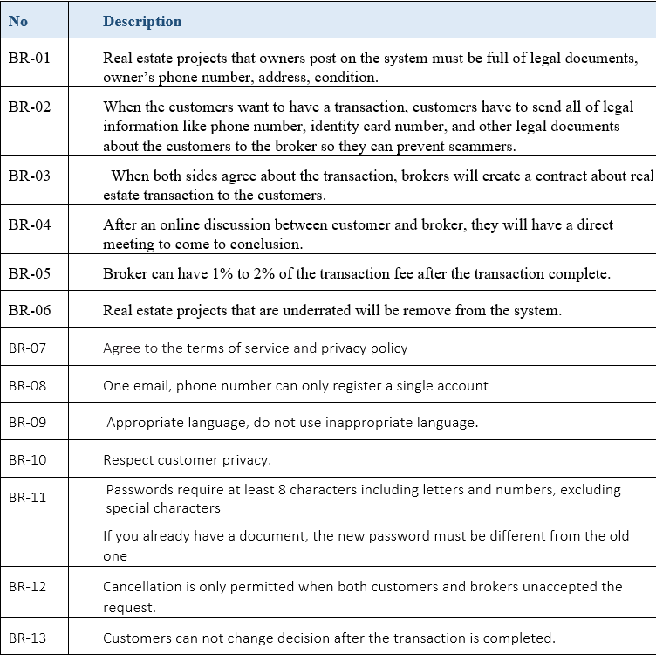
1.Overall Description 1.2 Business rules

Slide 6
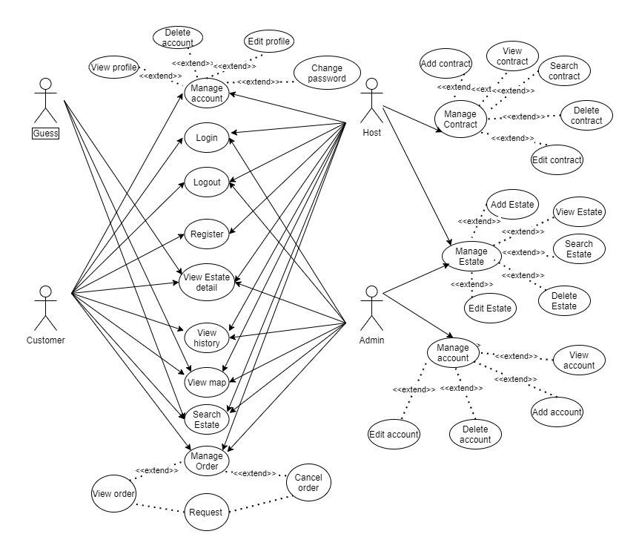
2.User requirement 2.1 Use-case diagram

Slide 7
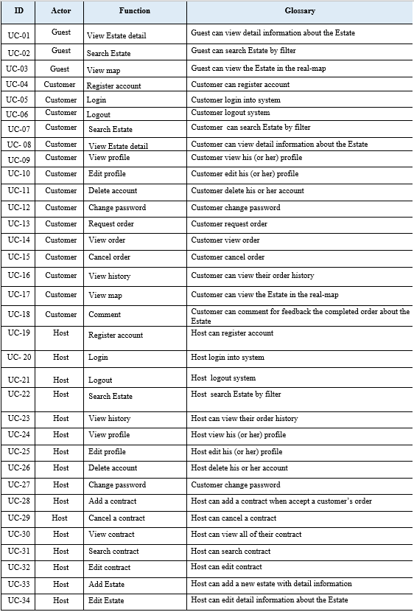
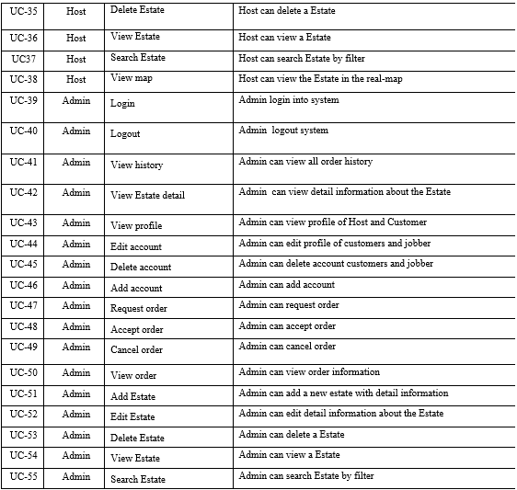
2.User requirement 2.1 Use-case list

Slide 8
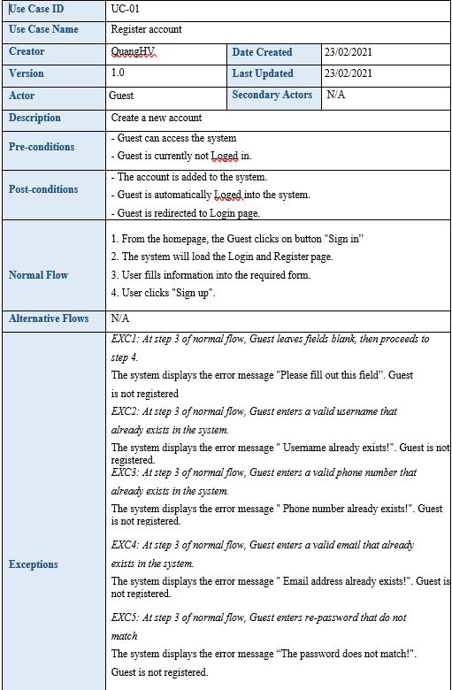
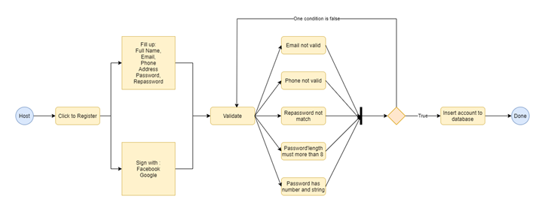
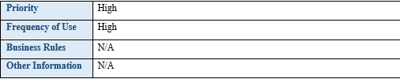
2.User requirement 2.1 Use-case list

Slide 9
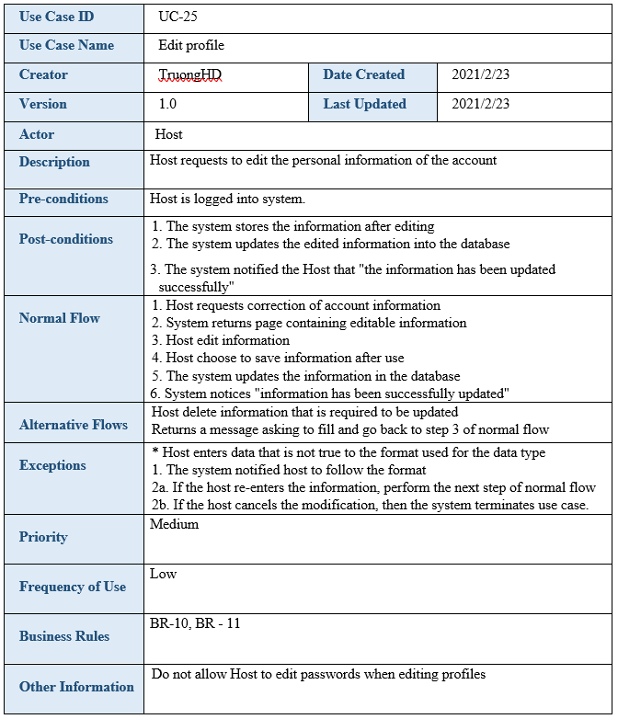
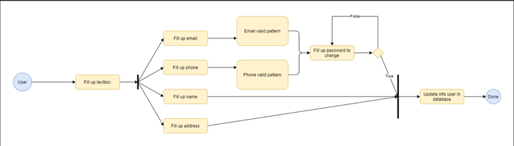
2.User requirement 2.1 Use-case list

Slide 10
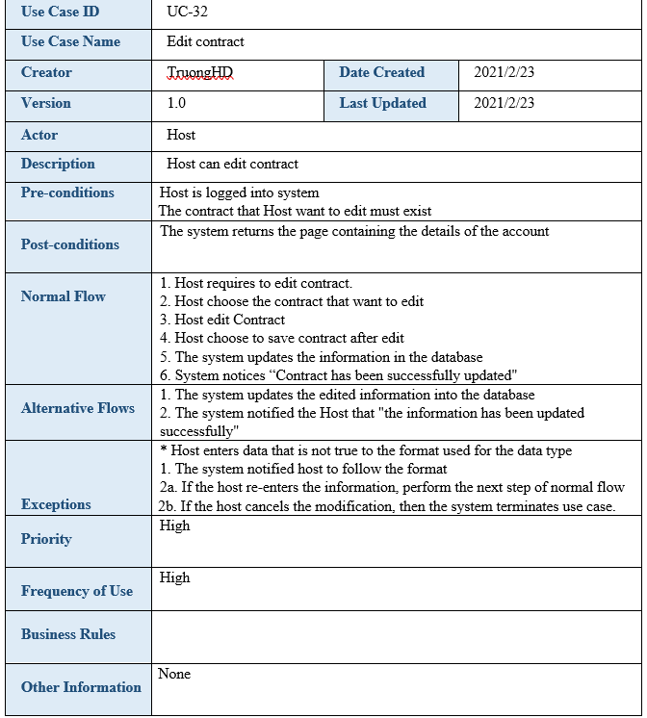
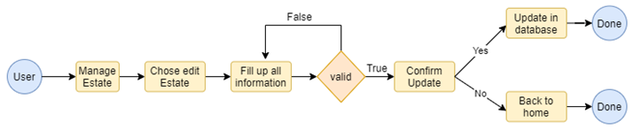
2.User requirement 2.1 Use-case list

Slide 11
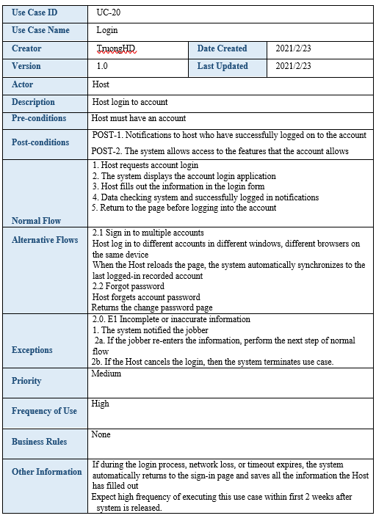
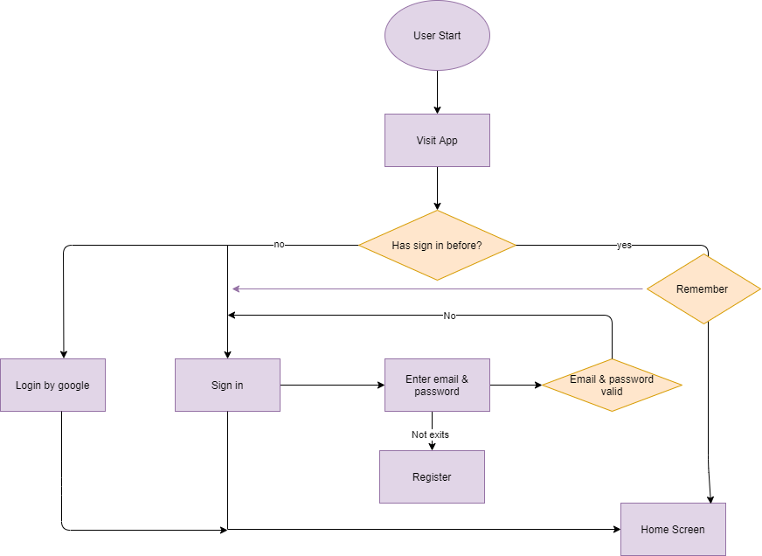
2.User requirement 2.1 Use-case list

Slide 12
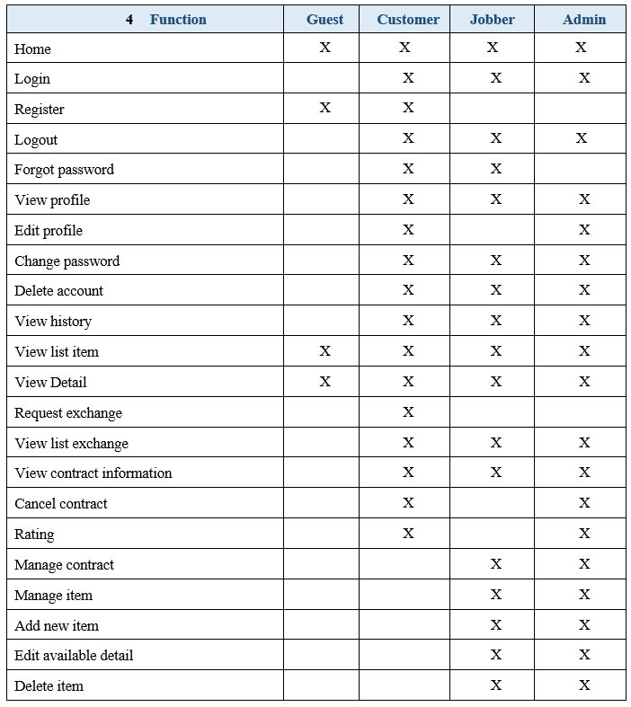
3.Functional requirement 3.1 Screen Authorization

Slide 13
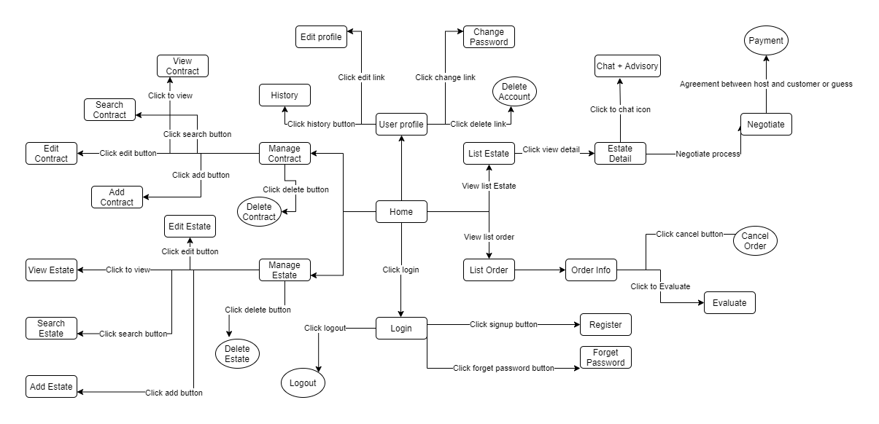
3.Functional requirement 3.2 System flowchart

Slide 14
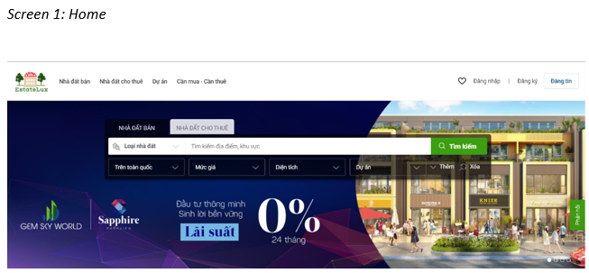
4.Non-Functional requirement 4.1 External Interface Requirements 4.1.1 User Interface

Slide 15
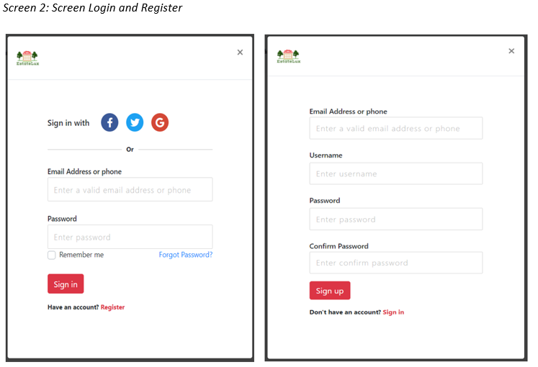
4.Non-Functional requirement 4.1 External Interface Requirements 4.1.1 User Interface

Slide 16
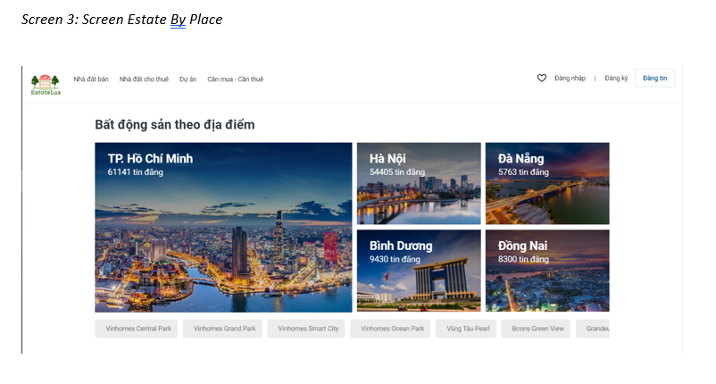
4.Non-Functional requirement 4.1 External Interface Requirements 4.1.1 User Interface

Slide 17
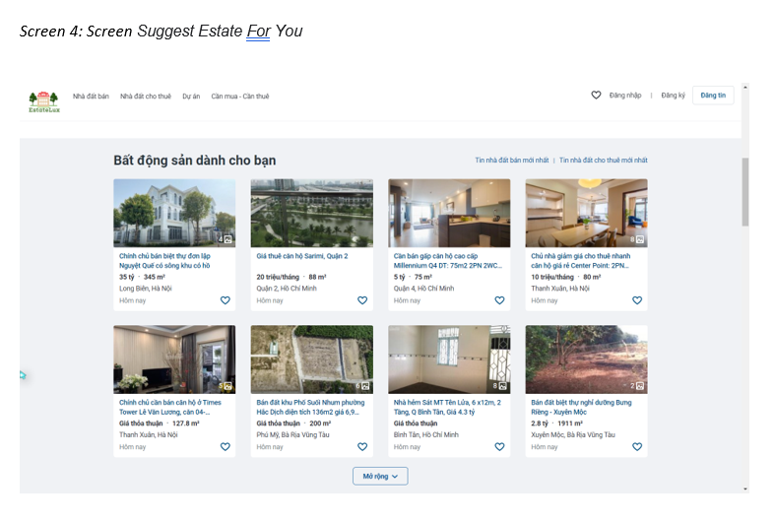
4.Non-Functional requirement 4.1 External Interface Requirements 4.1.1 User Interface

Slide 18
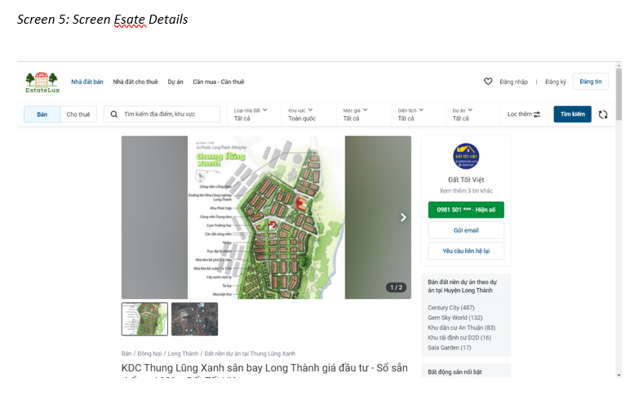
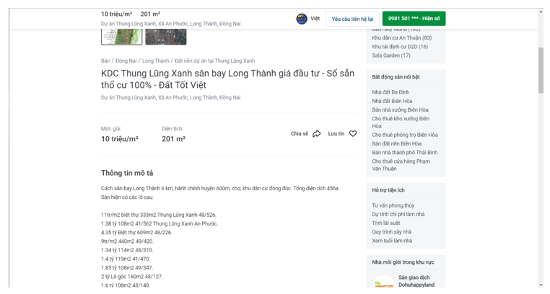
4.Non-Functional requirement 4.1 External Interface Requirements 4.1.1 User Interface

Slide 19
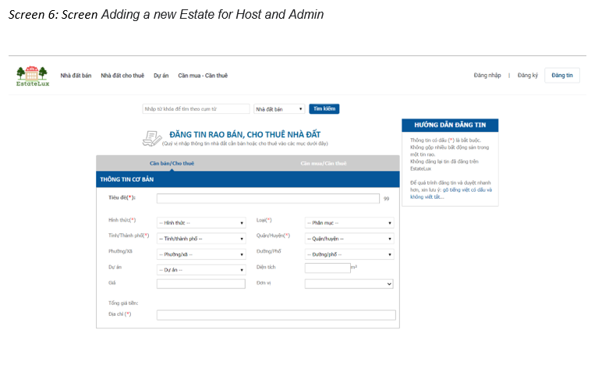
4.Non-Functional requirement 4.1 External Interface Requirements 4.1.1 User Interface

Slide 20
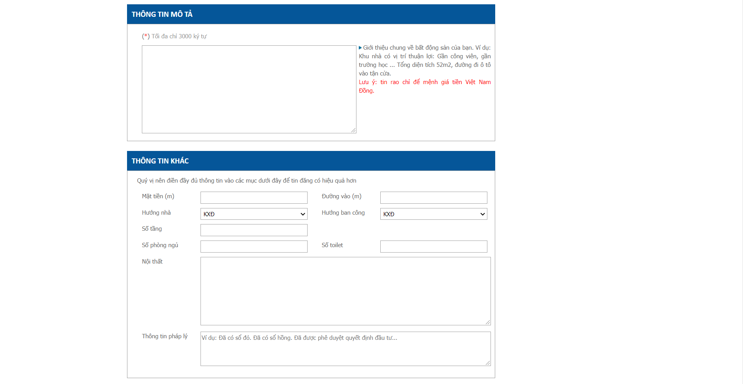
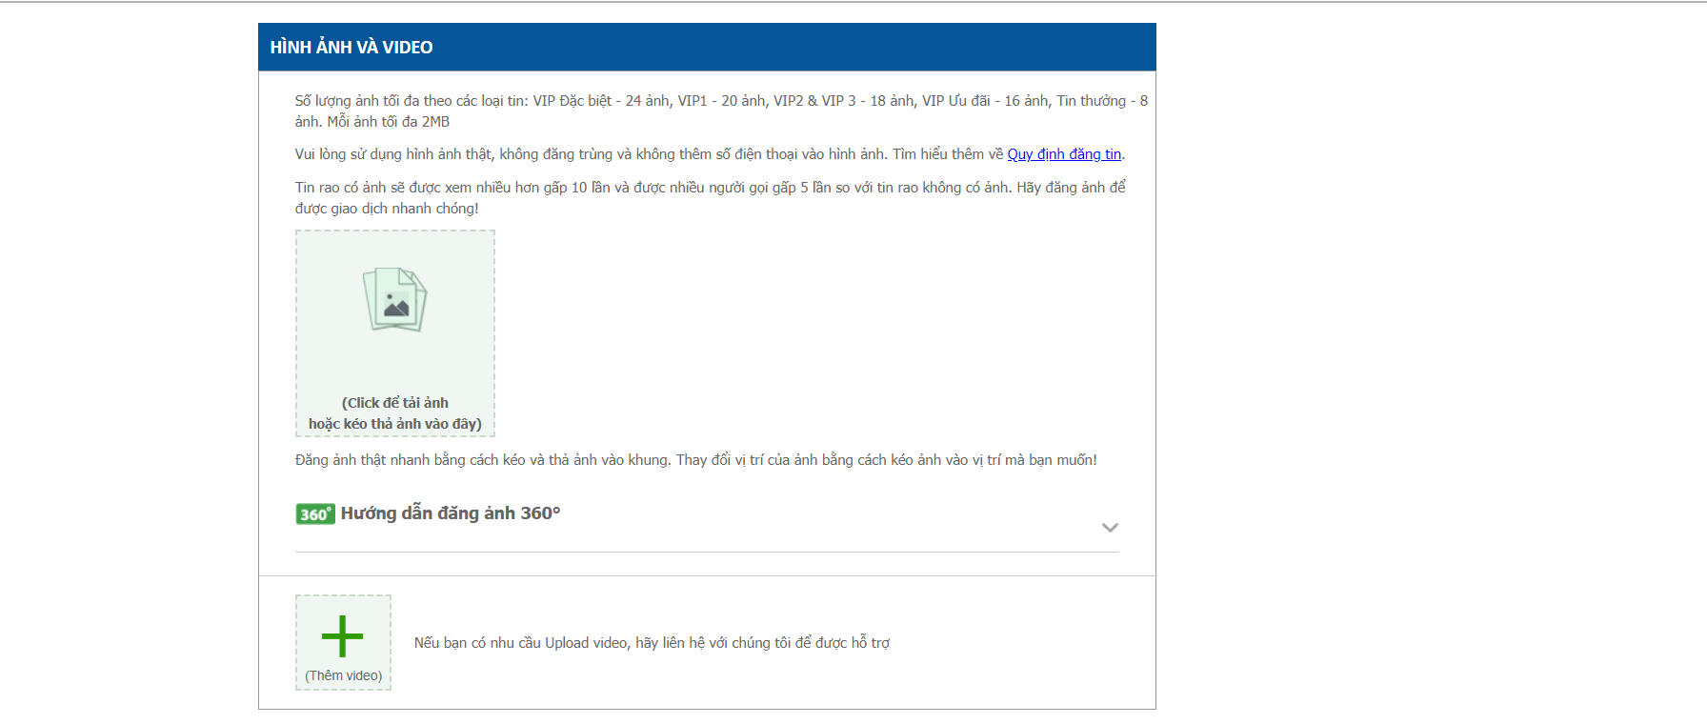
4.Non-Functional requirement 4.1 External Interface Requirements 4.1.1 User Interface

Slide 21
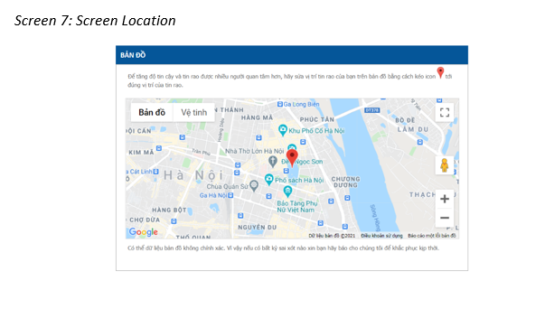
4.Non-Functional requirement 4.1 External Interface Requirements 4.1.1 User Interface

Slide 22
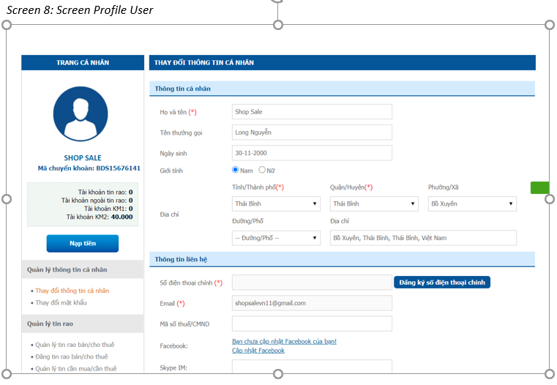
4.Non-Functional requirement 4.1 External Interface Requirements 4.1.1 User Interface

Slide 23
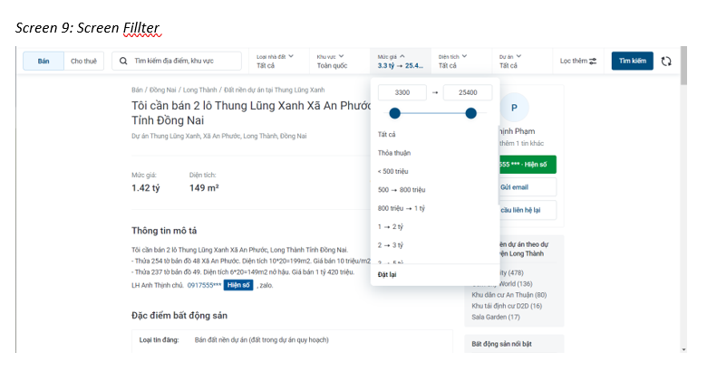
4.Non-Functional requirement 4.1 External Interface Requirements 4.1.1 User Interface

Slide 24
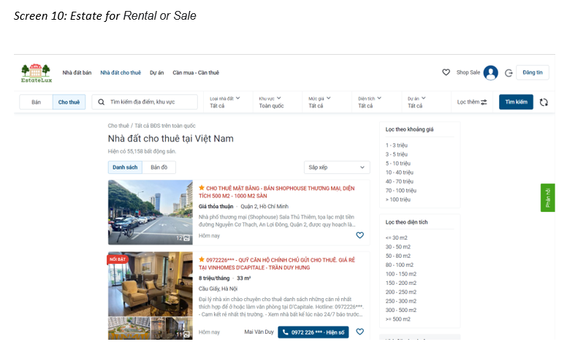
4.Non-Functional requirement 4.1 External Interface Requirements 4.1.1 User Interface

Slide 25
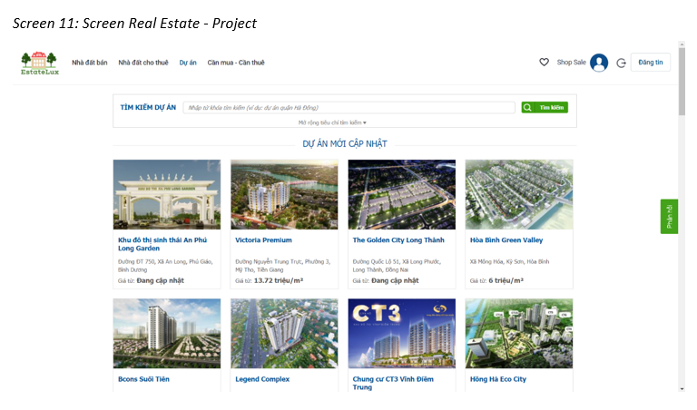
4.Non-Functional requirement 4.1 External Interface Requirements 4.1.1 User Interface

Slide 26
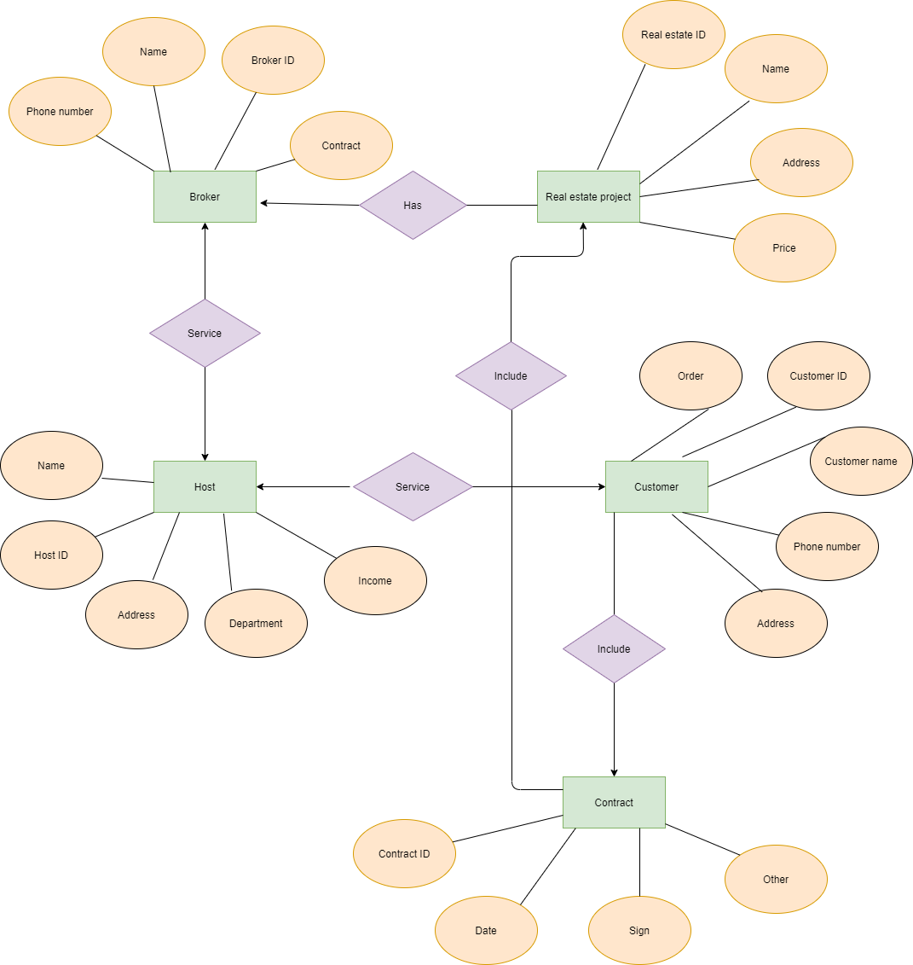
4.Other requirement Appendix A: Entity Diagram

Slide 27


